Slide 1
Ransomware Mitigation and Detection Techniques
Abdulla Khedr, 201702167
Faisal Abughazaleh, 201803362
Ali Mohammadian, 201807939
Marawan Mohammed, 201608191

Slide 2
Outline
Intro, impact.
How ransomware works.
Detection Techniques.
Mitigation Techniques.
Conclusion.
SECURITY

Slide 3
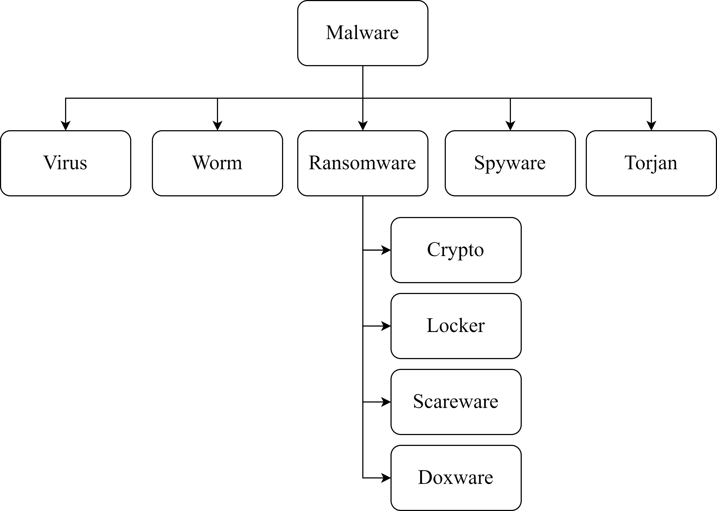
Malware
Malware is a malicious code or software that aims to damage a system or access data on a system without permission.
Types of Malware include:
Virus
Worm
Ransomware
Spyware
Trojan
And many others..!

Slide 4
Ransomware
A ransomware is a malware that prevents access to the user’s data by either encrypting the data or locking the whole device until a ransom is paid.
The main types of ransomware are:
Crypto Ransomware
Locker Ransomware
Scareware
Doxware

Slide 5
Types of Ransomware Detailed
Crypto Ransomware: Aims to encrypt the data on the computer, preventing access to it by the user. It is the most common form of malware.
Locker Ransomware: Aims to lock the computer completely, preventing access not only to the data, but to any computing power or service.
Scareware: Creates an unreal threat to convince the victim into downloading expensive software.
Doxware: Gains access to the user’s data and threatens to make it public unless a ransom is paid, like blackmailing.

Slide 6
Impact of Ransomware

Slide 7
People
01
04
Time
Revenue
02
05
Financial Assets
Reputation
03
06
Information and Data
An increase in mortality rates in affected hospitals due to the inability to provide critical services to patients
Days or weeks lost in efforts of recovery are expensive in downtime
A decline in revenue for businesses either to pay the ransom or because of downtime
Some businesses may have to shutdown due to a greatly affected reputation or a great financial loss
Companies affected will be victims of a damaged reputation. Employees in charge of IT security will be accused of not doing their job properly if affected by the attack
Finally, confidential information that companies hold like user data or trade secrets may be exposed by the attacker

Slide 8
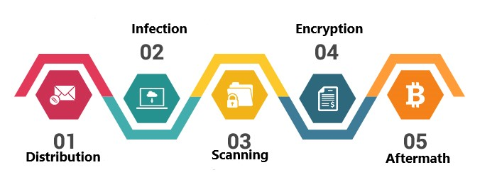
How ransomware works?

Slide 9
1-Distribution
Once developed, the code distribution process begins.
The code spreads through multi medium.
Attempt for making a random user download the ransomware.
Infection starts after a vulnerability is found.

Slide 10
2-Infection
Once installed, malware aims to create a connection with the attacker.
This allows them to download files required for the attack.
During this phase, processes are being called and executed in weird parts of the system.

Slide 11
3-Scanning
The malware scans the device for files to encrypt.
It scans the network for cloud accounts linked to the device.
The duration and prevention of this phase depends on the network’s size.

Slide 12
4-Encryption
When activated, the malware starts encrypting files.
Some may encrypt individual files, while others encrypt the master record of a file system.
To prevent recovery, backups get deleted or encrypted.
When the ransom is paid, symmetric key gets decrypted by the attacker’s private key. Then it is used to decrypt the files.

Slide 13
5-Aftermath
Once the attack was a success, The user is prompted with a message that warns him of data loss if the ransom is not paid by time stated.
The payment usually will be through Bitcoins.
The ransom may be doubled in some case, if the user did not pay up quickly.

Slide 14
Detection Techniques

Slide 15
Malware Detection
Signature-Based
Behavior-Based

Slide 16
Signature-Based Detection
Used by antivirus software
How it works:
Scan and analyze files.
Extract Malware Signature.
Compare with malware signature database.
Pros:
Fast And Efficient.
Cons:
Ineffective against ransomware.
Cybercriminals change the signature.
Zero-day ransomware signature is unknown.

Slide 17
Behavior-Based Detection A.k.a. Anomaly-based Detection
Detection based on malware actions and attack patterns
1
Deception Techniques
2
System Analysis Techniques
3
ML/AI Techniques

Slide 18

1- Deception
Honey Pots
Decoy files and folders.
Distributed in the system.
Normal applications do not access these files.
Detection possible If they are interacted with.

Slide 19
2- System Analysis
File System Analysis
Type and extensions.
New file content dissimilarity.
File Entropy (randomness).
Domain Analysis
A database of blacklisted domains.
Compare all domains.
System information
Monitor windows registry setting changes.

Slide 20
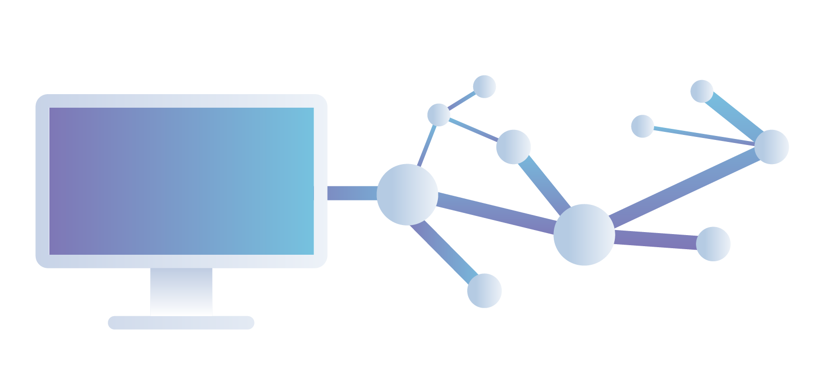

3- AI/ML
Determine ransomware behavior using a trained model
Network Traffic Analysis
Based On:
Message Size.
Number of Messages & Frequency.
IP Addresses (History/reputation).

Slide 21
Mitigation Techniques

Slide 22
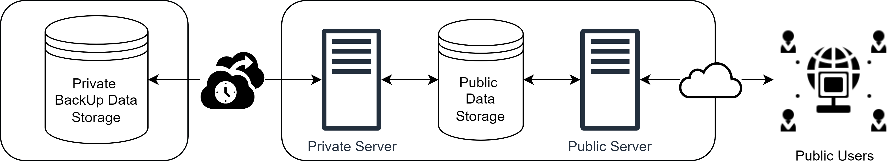
1- Backup and Recovery
The most effective solution against many types of malware including ransomware.
How and when?
Recovery point objective (RPO).
Recovery time objective (RTO).

Slide 23
2- Access Control
The first layer of defense.
Policies for accessing files.
Restricts ransomware.

Slide 24
3- Regular Updates
Operating Systems.
Applications.
Antiviruses.

Slide 25
4- User Awareness
User Trainings
Dangerous behavior
Various types of attacks
Phishing awareness

Slide 26
THANKS!
Question?

